Slide 1

American College of Sports Medicine
The Biological Basis of Sex Differences in Athletic Performance
Consensus Statement for the American College of Sports Medicine

Slide 2
2
To provide the latest scientific knowledge and mechanisms for the sex differences in athletic performance.
To highlight the differences in anatomy and physiology between males and females that are primary determinants of the sex differences in athletic performance and in response to exercise training.
To identify historical and non-physiologic factors that influence the sex differences in performance.
To identify gaps in the knowledge of sex differences in athletic performance and the underlying mechanisms, providing substantial opportunities for high-impact studies.
Purpose of the Consensus Statement

Slide 3
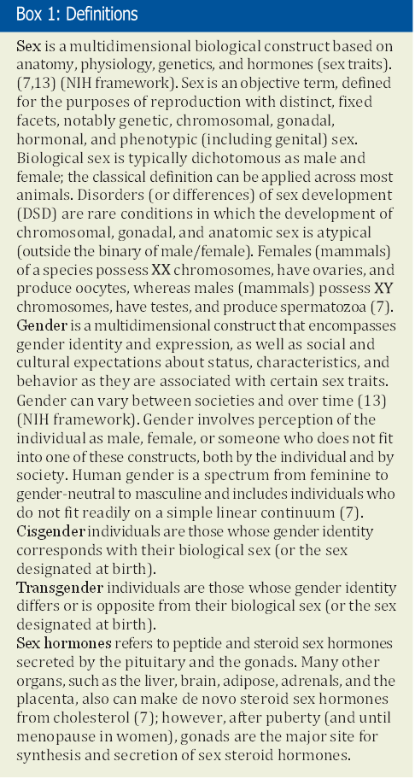
Introduction
3
Biological sex is a primary determinant of athletic performance because of fundamental sex differences in anatomy and physiology dictated by sex chromosomes and sex hormones.
Adult men are typically stronger, more powerful, and faster than women of similar age and training status.
For athletic events and sports relying on endurance, muscle strength, speed and power, males typically outperform females by 10-30% depending on the requirements of the event.
These sex differences in performance emerge with the onset of puberty and coincide with the increase in endogenous sex steroid hormones, in particular testosterone in males, which increases 30-fold by adulthood, but remains low in females.

Slide 4
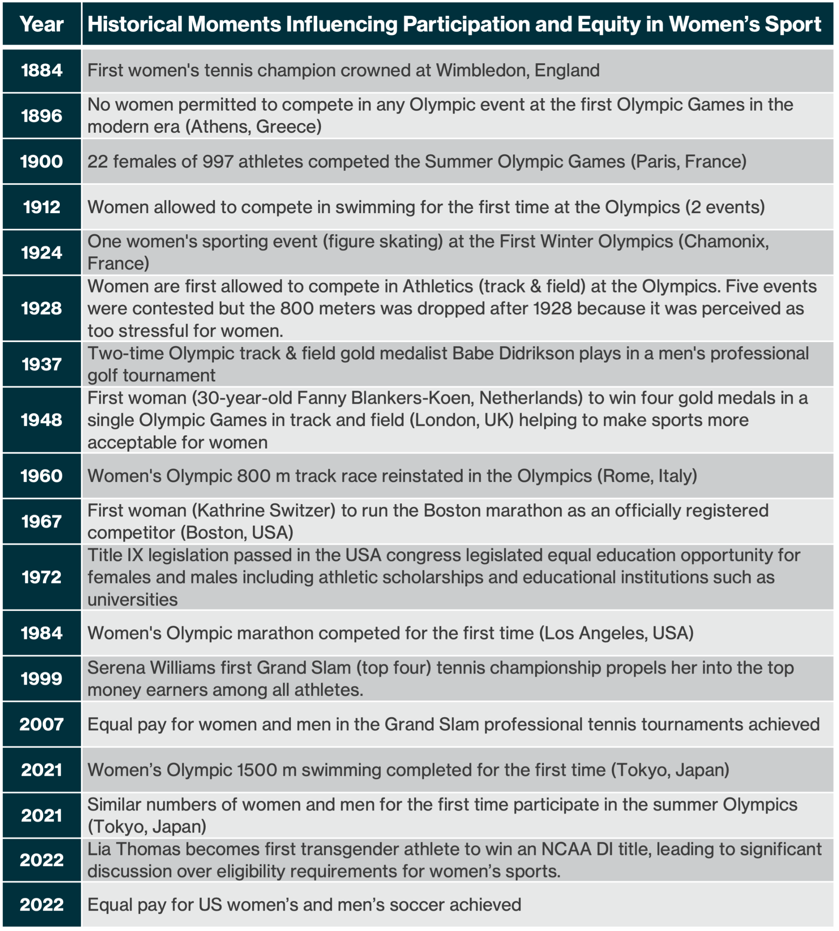

Table 1. Historical Events and Policy Influencing Participation and Equity in Women’s Sport and Health Research.
Historical Perspectives
The sex difference in performance is larger than explained by physiological and anatomical differences between males and females particularly among lower ranked athletes.
This is in part due to women having less opportunity, inequitable access to sports, facilities, and training than men, and higher dropout rates of female athletes than males.
Both past and present research studies of athletic performance, acute exercise and exercise training involve the testing of more men than women, or a lack of distinction between the sexes.
Consequently, because of the historical predominance of research and athletic participation of men compared with women, less is known about the physiology of women athletes, limits in their athletic ability, and the acute and adaptive response of women to exercise and training relative to men.

Slide 5
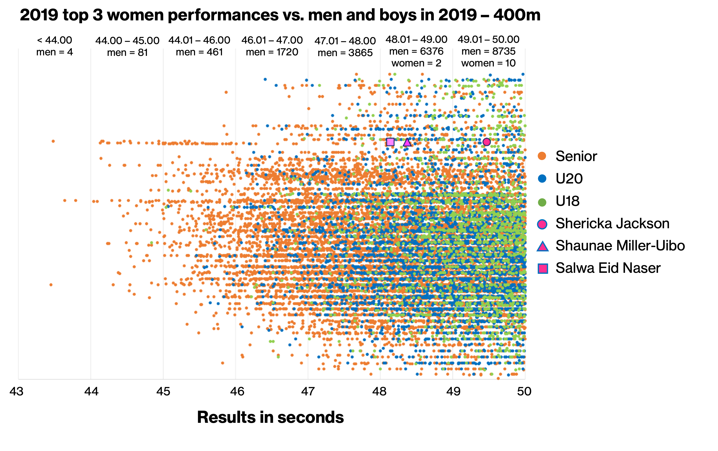
Sex Differences in Athletic Performance
5
The rate of improvement in athletic performance of women has exceeded that of men in the last 100 years across a multitude of sports as women have gained access to training, equipment, facilities, and opportunities.
Sex differences in athletic performance that involve strength, power and/or endurance are sizable and determined by biological differences between males and females.
Adult men on average are stronger, more powerful, and faster over short and long distances than women of similar age and training status.
Sex differences in the world records and best performances of athletic events that rely on endurance and muscular power range from approximately 10 to 30%.
These differences primarily represent the physical and anatomical abilities and limitations of males and females, largely independent of motivation, and access/opportunity to elite level training.
FIGURE 1. Top 400 m Track Running Performances in 2019 of Women
(top three) and Men (senior, U20 and U18) Who Ran Faster than 50 seconds.

Slide 6

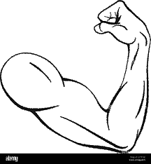
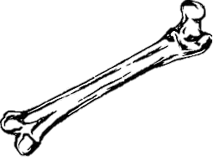
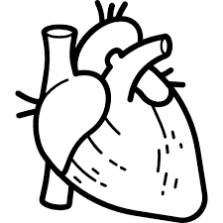
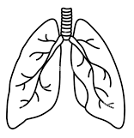
Biological Mechanisms for Sex Differences in
Athletic Performance
Exposure to high levels of endogenous testosterone in males at the onset of puberty (~12 years) is the primary determinant for the large sex difference in athletic performance during puberty and in adulthood.
Prior to puberty, sex differences in athletic performance are minimal.
Testosterone, a powerful anabolic steroid, increases ~20 to 30-fold in males during puberty and is 15x higher than adult females.
The direct and indirect effects of testosterone in males (relative to females) during puberty impact several aspects of athletic performance including muscular and anaerobic power, body composition and anthropometrics, and aerobic power.
Estradiol, the primary female sex steroid hormone, fluctuates during the menstrual cycle in females and does not have the same anabolic effects as testosterone. It is important in maintaining body composition including bone mass, skeletal muscle, fat mass, and tendon protein metabolism.

Slide 7
Biological Mechanisms for Sex Differences in
Athletic Performance
Muscular and Anaerobic Power
Males have increased skeletal muscle mass than females due to larger muscle fiber cross-sectional area, particularly Type II myosin heavy chain fibers.
The muscle mass and limb power of males can be twice that of females. For example, compared to similarly active males, females achieve:
  50-60% and 60-80% of the upper and lower body strength.
  63-67% of peak power during cycling and knee extensor single limb exercise.
  ~15-50% lower maximal anaerobic power during lower-limb maximal exercise.
Body Composition and Anthropometrics
Compared to females, males are ~8% taller with longer upper and lower limbs.
Males are heavier than females, with greater lean body mass (muscle and bone) and lower percentage of fat mass.
Female athletes typically have ~5-10% more body fat than similarly trained males and ~85% of the lean body mass.
Aerobic Power
Males have larger airways and lungs, larger ventricular mass and cardiac volumes, and higher hemoglobin concentration and mass than females.
Elite female endurance athletes’ VO₂max is ~10-14% lower than similarly trained males when normalized to body mass.

Slide 8
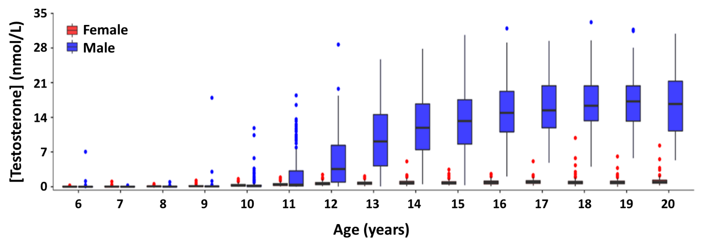
Biological Mechanisms for Sex Differences in Athletic Performance
FIGURE 6.
Type II (Fast) fiber area
(%, proportional area of the cross section of the sample) of skeletal muscle in males and females.
FIGURE 7.
Total testosterone concentrations of the US population aged 6 to 20 years.

Slide 9
Effects of Sex Hormones on Various Physiological Systems
9
Table 3. Actions of Sex Steroid Hormones.
Many of the sex differences of the major attributes that determine performance are dictated by the strong effect of endogenous sex hormones, primarily testosterone, during and following growth and development.
Endogenous testosterone in boys will rise 30-fold at the onset of puberty but remains lows in females.
In contrast, endogenous female sex hormones, like estradiol (E2), experience the menstrual cycle and monthly fluctuations.
Unlike androgens, E2 does not have the same anabolic effects as testosterone.
Growth hormone and insulin like growth factor-1 are associated with increased protein synthesis, muscle growth and repair, but does not result in significant increases in strength, exercise capacity, and muscle function.

Slide 10
Models That Provide Insight Into The Role of Sex Steroid Hormones
10
Testosterone suppression/addition conditions (Estrogen suppression/addition conditions)
Testosterone addition in females results in increased muscle mass and muscle fiber size, increased hemoglobin concentration and mass, improved strength, and endurance performance.
Testosterone suppression in adult males results in initial decreases in muscle mass, increased fat mass, although the loss of lean mass and strength is not to the levels of adult females at least up to 3 years post.
Biologic males who undergo partial or complete male puberty followed by testosterone suppression, retain some advantage in power and endurance performance over biological females, at least up to 2 years post.
Hormonal disorders
Disorders (differences) of sex development (DSD) are rare conditions in which the development of chromosomal, gonadal, and anatomic sex is atypical.
Their prevalence is overrepresented in elite women athletes by 140-fold relative to the general population.

Slide 11
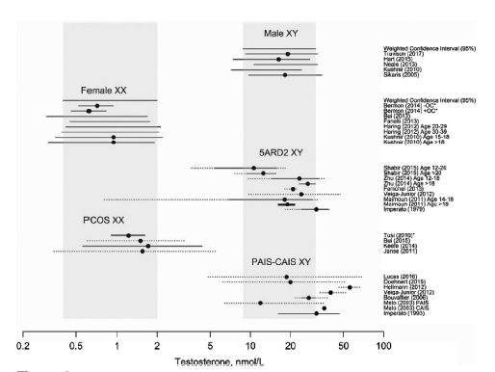
Models That Provide Insight Into The Role of Sex Steroid Hormones
11
Polycystic Ovary Syndrome (PCOS): PCOS presents as a combination of signs and symptoms of androgen excess and ovarian dysfunction (oligo-ovulation/anovulation and/or polycystic ovaries) in the absence of other specific diagnoses.
Such women are biological females with XX chromosomal complement and ovaries and have a feminizing puberty.
Hyperandrogenism is a key component of PCOS diagnosis. Although women with PCOS may have testosterone levels above the normal range for biological females, it is typically well below the male range.
DSD: Rare conditions in which the development of chromosomal, gonadal, and anatomic sex is atypical (outside the binary of male/female).
Androgen insensitivity syndrome (AIS) is a 46, XY DSD that leads to resistance to androgens, including testosterone.
5α-reductase deficiency type 2 (SRD5A2) is a 46, XY DSD that converts testosterone to dihydrotestosterone. At puberty, these individuals will undergo virilization and develop various degrees of male-like phenotype.
Congenital adrenal hyperplasia (CAH) is a group of autosomal recessive genetic disorders where the adrenal glands lack the proteins and enzymes involved in cortisol biosynthesis. Most commonly, the adrenal glands produce too little cortisol and/or aldosterone and too much androgen leading to varying degrees of hyperandrogenism in XX individuals.
FIGURE 2. Circulating Testosterone Concentrations in Adult Males and Females.

Slide 12
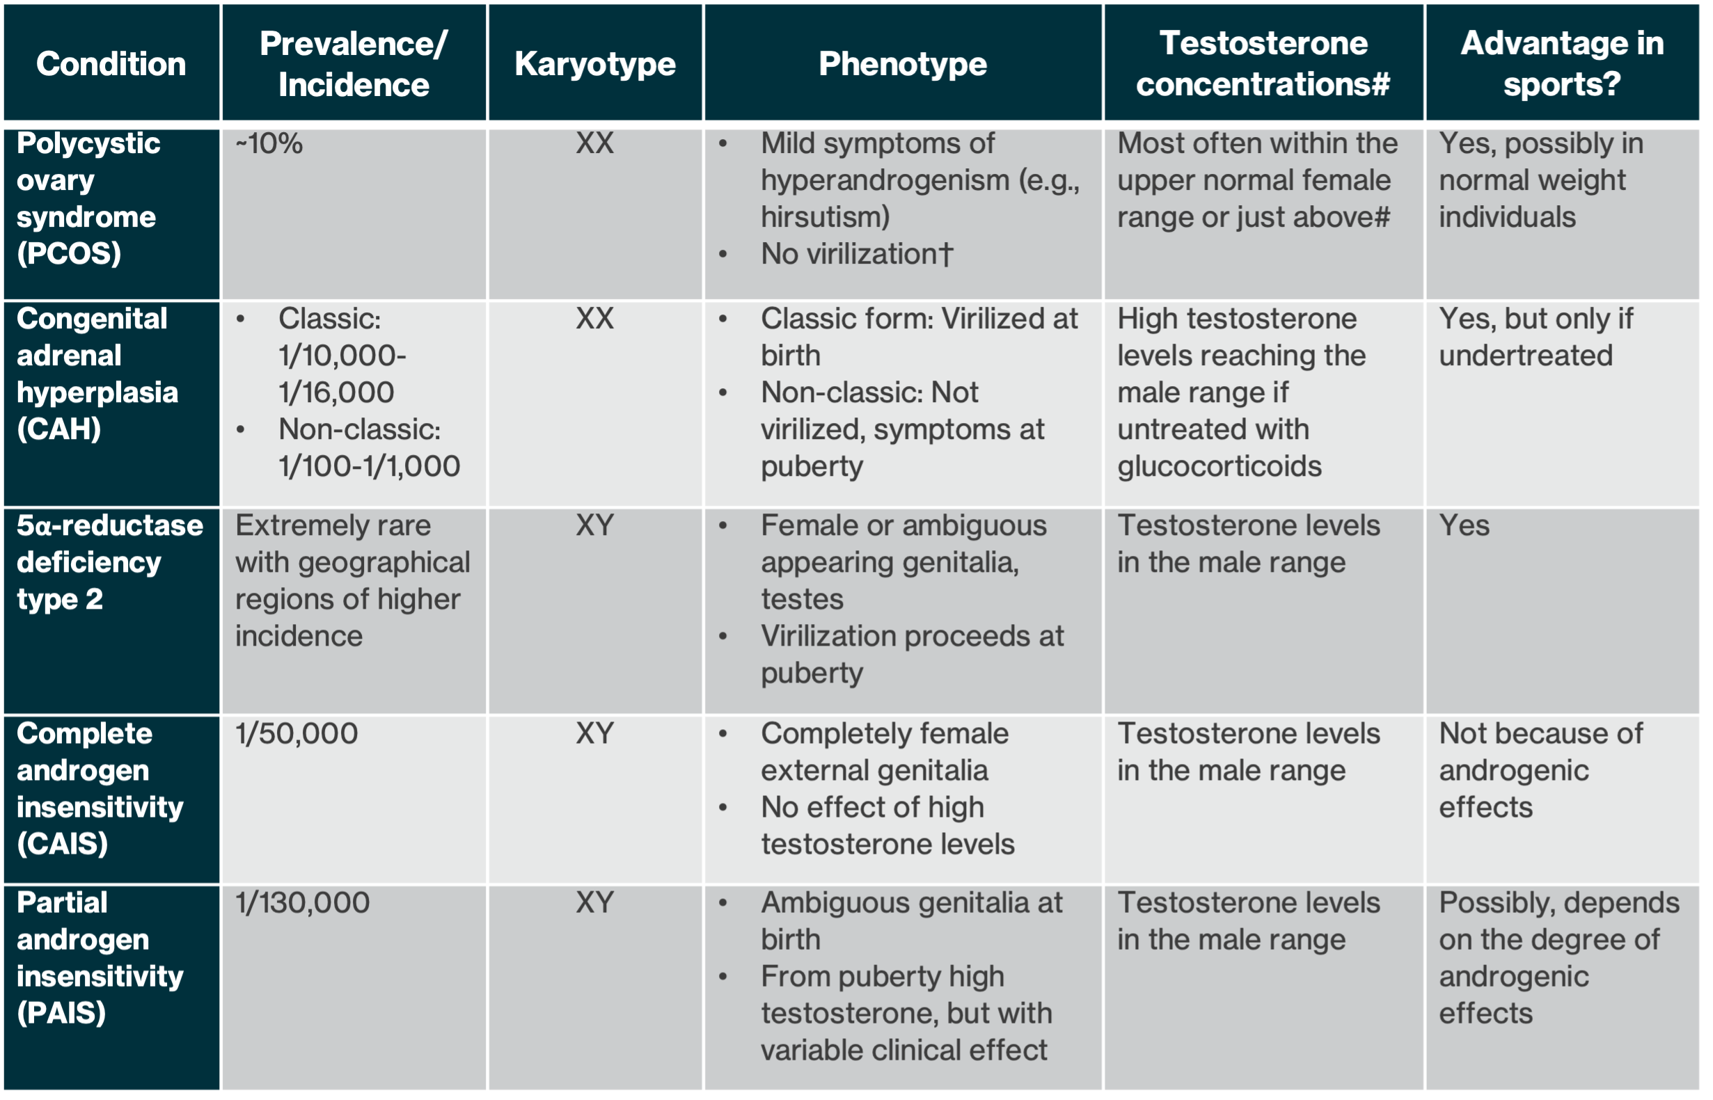
Table 4. Examples of Conditions of Endogenous Hyperandrogenism and Disorders (or Differences) of Sex Development and the Potential Advantage for Physical Performance in Women.
12
#Serum testosterone normal range for female: 0.1-1.8 nmol/L and male: 7.7-29.4 nmol/L.
†Virilizing symptoms: muscle growth, increase in body hair (hirsutism), hair loss of male type, deepening of the voice, breast atrophy, and enlargement of the clitoris.

Slide 13
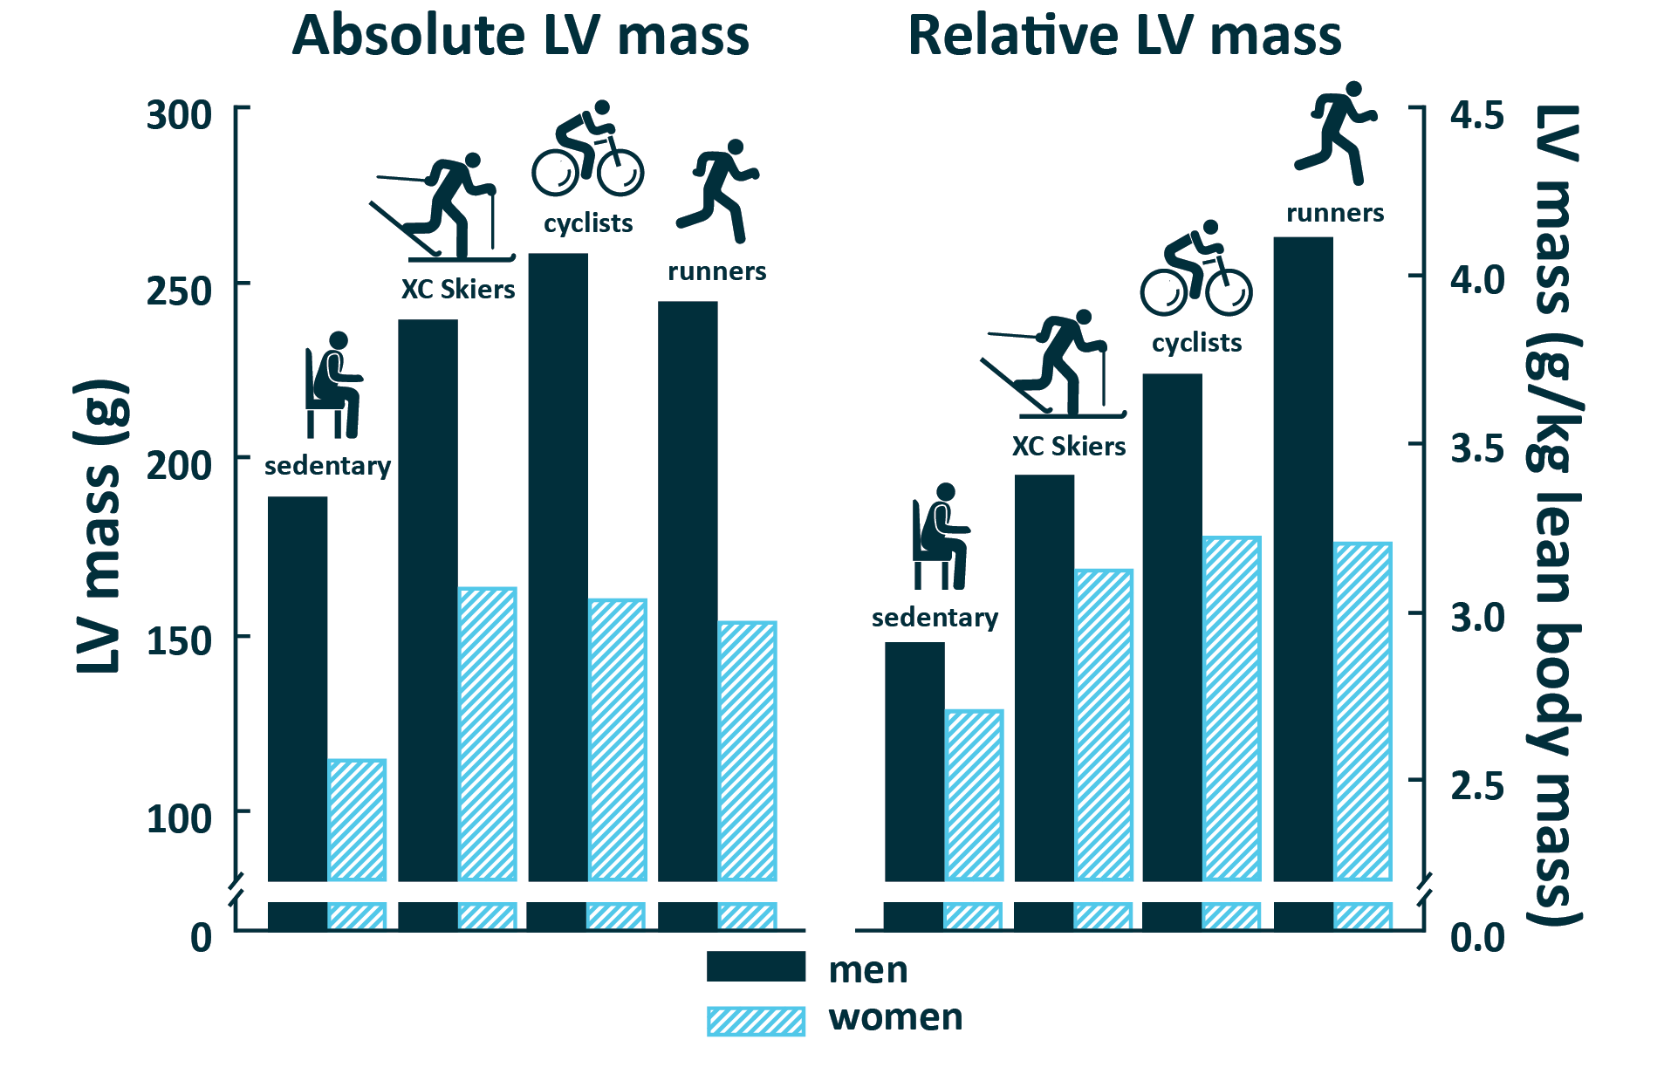
Training Adaptations to Exercise in Males and Females
13
Male athletes have large hearts (left ventricles) compared to females when normalized for lean body mass
Males and females exhibit similar relative (percentage) increases in performance and adaptations in response to short term (6-12 weeks) high-resistance and endurance training.
‘Muscle memory’ may play an important role in individuals who have previously been exposed to high levels of testosterone (e.g., male puberty) and who undergo suppression of testosterone but retain the ability to hypertrophy in response to resistance training and more so than those not exposed to testosterone.
Males exhibit larger adaptations of ventricular mass than females after long-term endurance training (>9 months) possibly facilitated by high concentrations of endogenous testosterone.
FIGURE 11. Cardiac Mass (Absolute and Relative to Lean Body Mass) of Male and Female Athletes and Sedentary Controls.
LV: left ventricular.

Slide 14
Summary and Conclusions
14
FIGURE 3.
Progression of World Record Performances by Men and Women for the Marathon and 100 Meter Sprint.
A. World record times in marathon for men and women from when women could legally compete (1970 onwards).
B. The sex difference in the world record (WR) marathon times.
C. World record times in the outdoor 100-meter sprint for men and women from when women could legally compete (1922 onwards).
Biological sex is a determinant of athletic performance: adult males are faster, stronger, more powerful than females.
The fastest and most powerful males outperform the fastest and most powerful females.
The sex differences in athletic performance where endurance or muscular power are required is ~10-30% and varies depending on the requirements of the event.
The largest sex differences in performance occurs in sports that rely on muscular power such as weightlifting and jumping.
The rate of improvement in athletic performance of women has exceeded that of men in the last 100 years across a multitude of sports as women have gained access to training, equipment, facilities, and opportunities.

Slide 15
Summary and Conclusions
15
The primary cause for the large sex difference in athletic performance is exposure to high levels of endogenous testosterone, a powerful androgenic steroid, that increases ~20-30-fold in males during puberty and is 15x higher than adult females.
Estradiol, which fluctuates during the menstrual cycle in females, does not have the same anabolic effects as testosterone but is important in maintenance of body composition including bone mass, skeletal muscle, fat mass, and tendon protein metabolism.
Growth hormone and insulin like growth factor-1 are associated with increased protein synthesis, muscle repair and some improvements in strength but do not explain the large sex differences in athletic performance.
Non-hormonal factors that may impact the sex differences in height determination and thus athletic performance include possession of the Y chromosome (greater height) and or the X chromosome (shorter height).
The effects of the sex steroid hormones, particularly the potent, quick-acting and long-lasting effects of testosterone, are evident in: 1) experiments/studies where sex steroid hormones have been added or suppressed in both males and females, 2) studies of the physiology and performance of individuals with various DSDs, and 3) studies of transgender men and transgender women in response to gender affirming hormone treatment (GAHT).

Slide 16
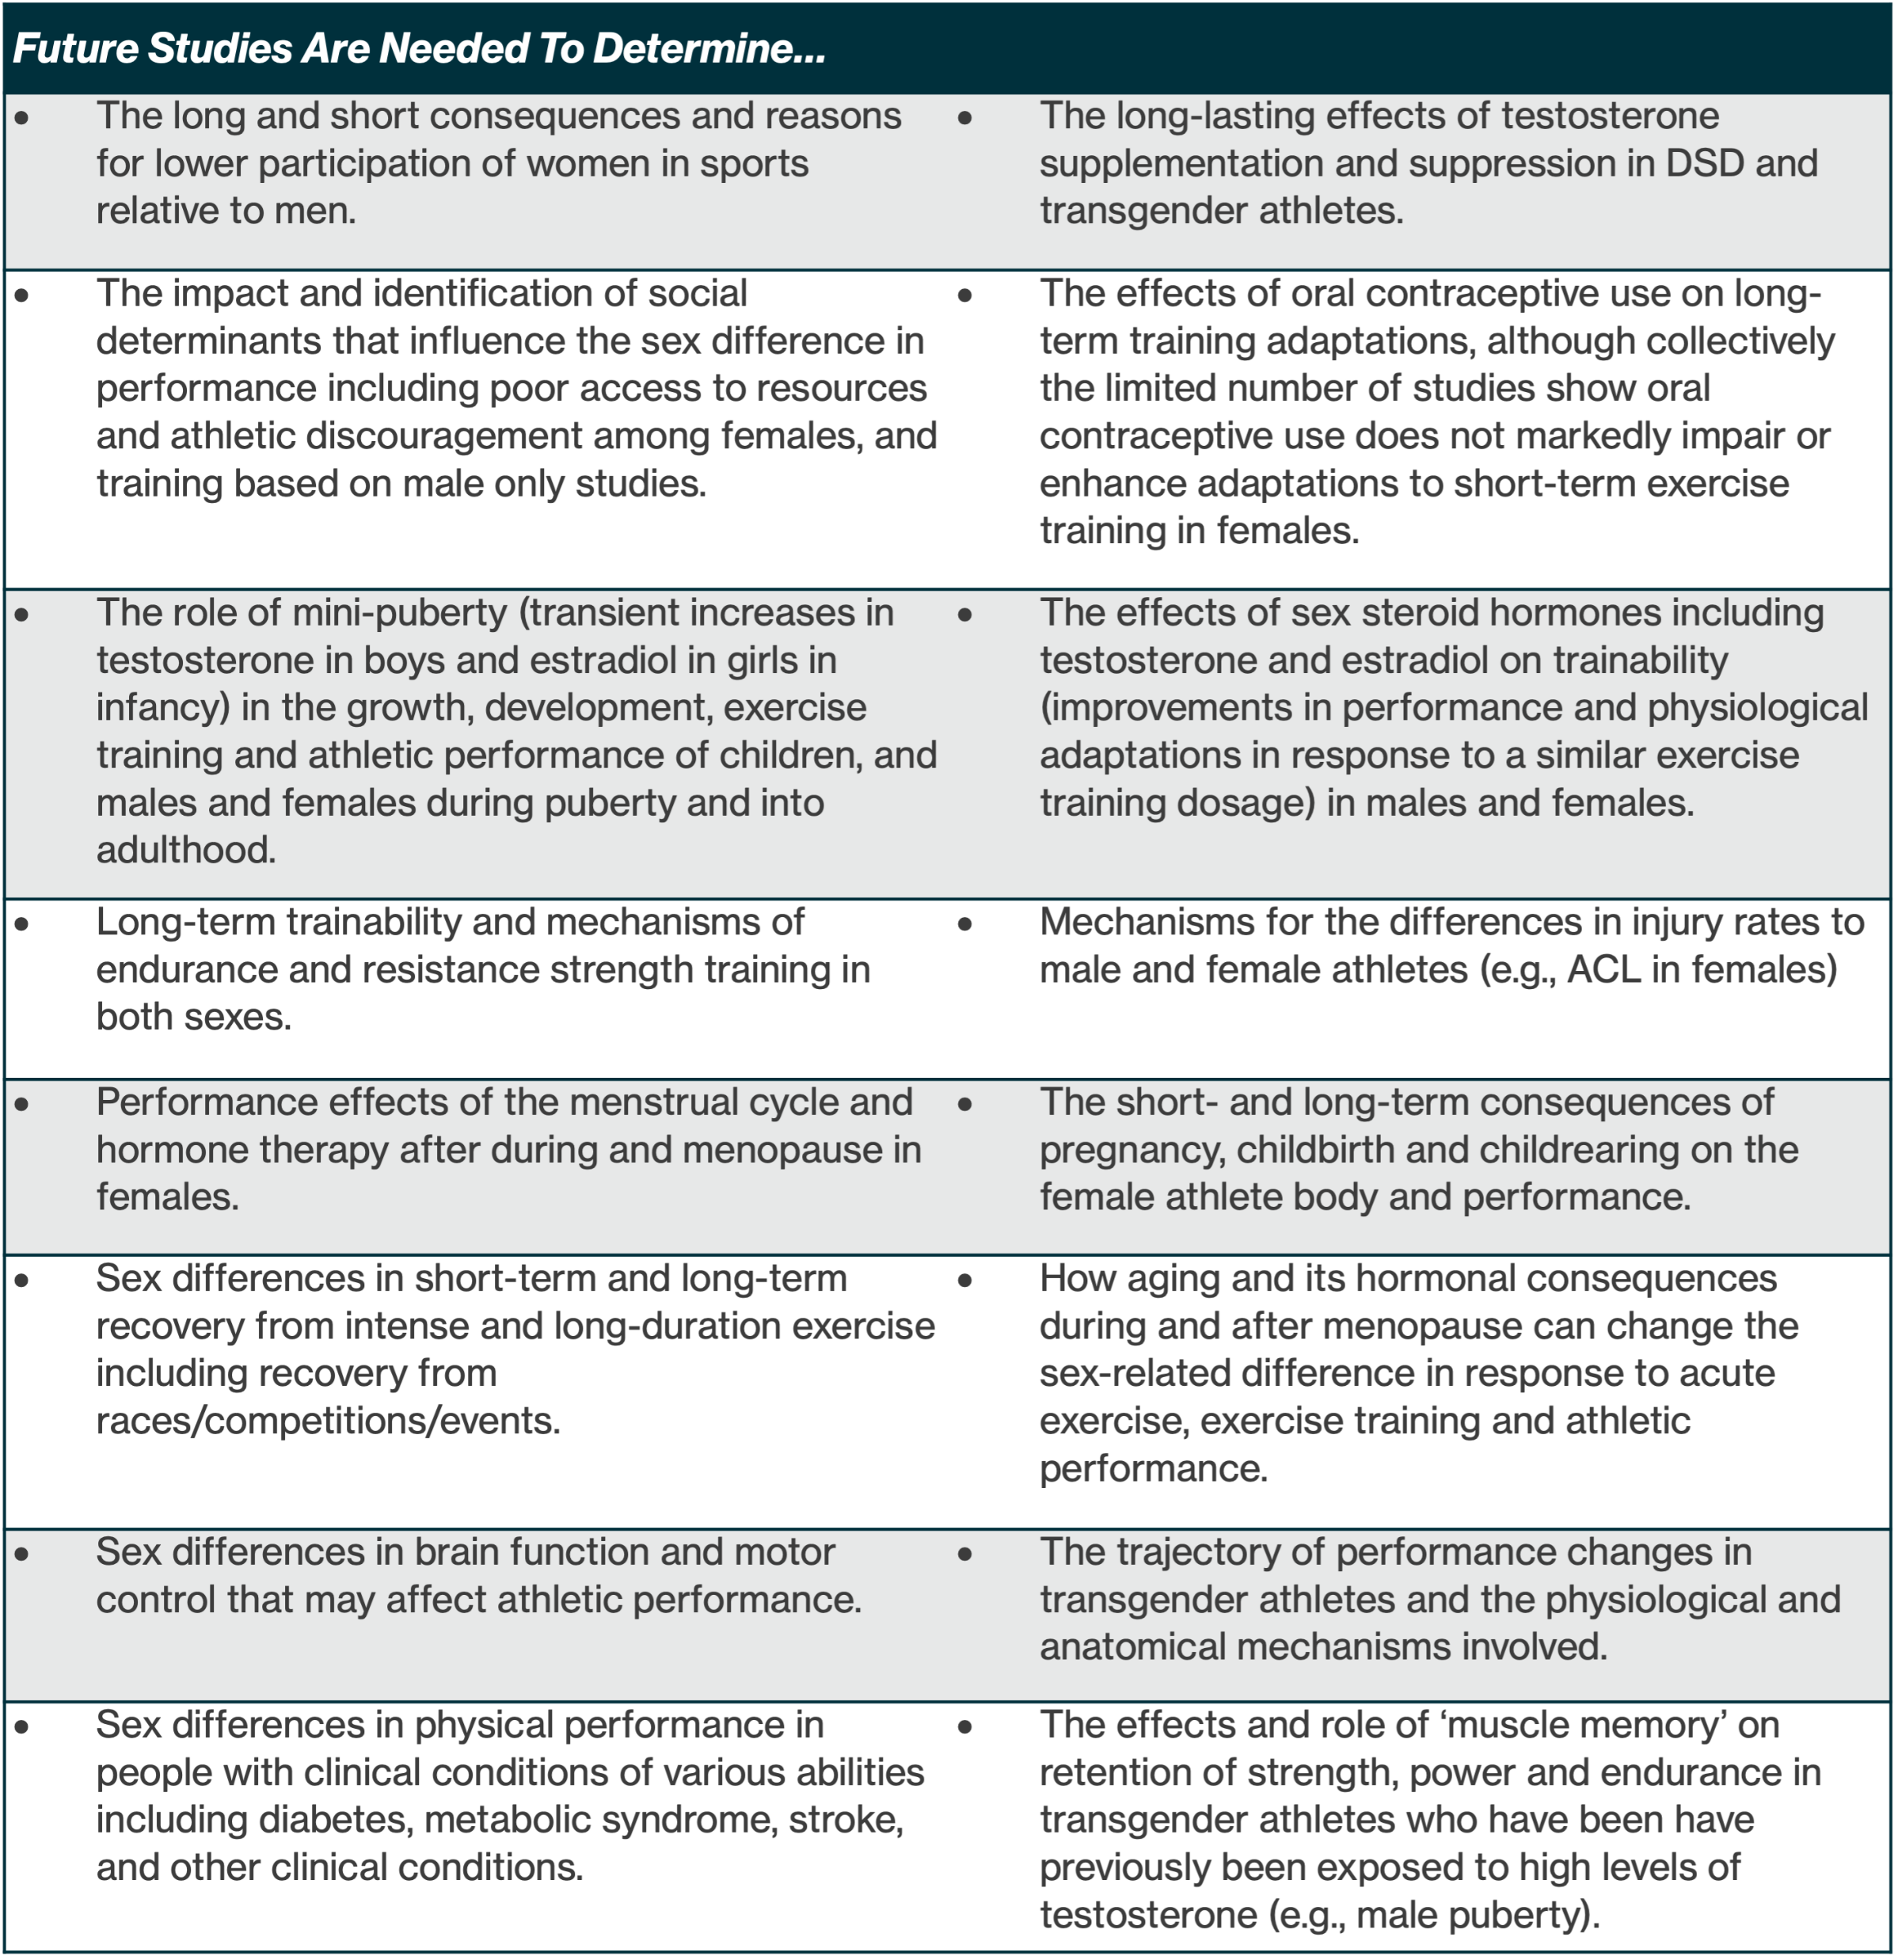
Future Directions and Opportunities
16
A mandate to include sex as a biological variable across all studies of athletic performance, and exercise science.
This would involve including women at all levels, and studies to be adequately powered to understand sex differences in the acute and chronic exercise responses.
Declare the sex of the participants in the title and abstract of published studies.

Slide 17
Acknowledgements
This slide deck was prepared by the ACSM Evidence-Based Practice Committee in collaboration with the authors.

Slide 18
References
Bhargava A, Arnold AP, Bangasser DA, et al. Considering sex as a biological variable in basic and clinical studies: an endocrine society scientific statement. Endocr Rev. 2021;42(3):219–58.
National Institutes of Health. Sex & Gender. Available from: https://orwh.od.nih.gov/sex-gender#:~:text=%22Sex%22%20refers%20to%20biological
%20differences,across%20societies%20and%20over%20time.2022.
Joyner MJ, Hunter SK, Lucia A, Jones AM. Physiology and fast marathons. J Appl Physiol (1985). 2020;128(4):1065–8. PubMed PMID: 31944889. doi:10.1152/japplphysiol.00793.2019.
Hunter SK, Stevens AA. Sex differences in marathon running with advanced age: physiology or participation? Med Sci Sports Exerc. 2013;45(1):148–56.
Seidler RD, Bernard JA, Burutolu TB, et al. Motor control and aging: links to age-related brain structural, functional, and biochemical effects. Neurosci
Biobehav Rev. 2010;34:721–33. doi:10.1016/j.neubiorev.2009.10.005.
Whipp BJ, Ward SA. Will women soon outrun men? Nature. 1992;355(6355):25
Hunter SK, Stevens AA, Magennis K, Skelton KW, Fauth M. Is there a sex difference in the age of elite marathon runners? Med Sci Sports Exerc. 2011;
43(4):656–64. PubMed PMID: 20881885.
Kilpatrick M, Hebert E, Bartholomew J. College students’ motivation for physical activity: differentiating men’s and women's motives for sport participation and exercise. J Am Coll Heal. 2005;54(2):87–94.
Suggs W. A Place on the Team: The Triumph and Tragedy of Title IX. Princeton (NJ): Princeton University Press; 2005.
Perras C. Moving towards equal pay for professional female athletes: what we can learn from equal pay legislation in iceland. Ind Intl Comp L Rev.
2019;30:319–48.
Handelsman DJ, Hirschberg AL, Bermon S. Circulating testosterone as the hormonal basis of sex differences in athletic performance. Endocr Rev.
2018;39(5):803–29.
Senefeld JW, Lambelet Coleman D, Johnson PW, Carter RE, Clayburn AJ, Joyner MJ. Divergence in timing and magnitude of testosterone levels between
male and female youths. JAMA. 2020;324(1):99–101

Slide 19
Handelsman DJ. Sex differences in athletic performance emerge coinciding with the onset of male puberty. Clin Endocrinol. 2017;87(1):68–72.
Senefeld JW, Clayburn AJ, Baker SE, Carter RE, Johnson PW, Joyner MJ. Sex differences in youth elite swimming. PLoS One. 2019;14(11):e0225724.
Senefeld JW, Lambelet Coleman D, Johnson PW, Carter RE, Clayburn AJ, Joyner MJ. Divergence in timing and magnitude of testosterone levels between male and female youths. JAMA. 2020;324(1):99–101.
Sandbakk Ø, Solli GS, Holmberg HC. Sex differences in world-record performance: the influence of sport discipline and competition duration. Int J
Sports Physiol Perform. 2018;13(1):2–8.
Schlegel P, Křehký A. Performance sex differences in CrossFit®. Sports (Basel). 2022;10(11):165. PubMed PMID: 36355816; PubMed Central
PMCID: PMC9699255. doi:10.3390/sports10110165.
Keenan KG, Senefeld JW, Hunter SK. Girls in the boat: sex differences in rowing performance and participation. PLoS One. 2018;13(1):e0191504.
Senefeld J, Joyner MJ, Stevens A, Hunter SK. Sex differences in elite swimming with advanced age are less than marathon running. Scand J Med Sci
Sports. 2016;26(1):17–28.
O'Bryan SM, Connor KR, Drummer DJ, Lavin KM, Bamman MM. Considerations for sex-cognizant research in exercise biology and medicine. Front
Sports Active Living. 2022;4:903992. doi:10.3389/fspor.2022.903992
Hunter SK. The relevance of sex differences in performance fatigability. Med Sci Sports Exerc. 2016;48(11):2247–56.
Miller AE, MacDougall JD, Tarnopolsky MA, Sale DG. Gender differences in strength and muscle fiber characteristics. Eur J Appl Physiol Occup Physiol.
1993;66(3):254–62
Alway SE, Grumbt WH, Gonyea WJ, Stray-Gundersen J. Contrasts in muscle and myofibers of elite male and female bodybuilders. J Appl Physiol. 1989;
67(1):24–31.
Staron RS, Hagerman FC, Hikida RS, et al. Fiber type composition of the vastus lateralis muscle of young men and women. J Histochem Cytochem.
2000;48(5):623–9. PubMed PMID: 10769046.
Toft I, Lindal S, Bonaa KH, Jenssen T. Quantitative measurement of muscle fiber composition in a normal population. Muscle Nerve. 2003;28(1):101–8.

Slide 20
Haizlip KM, Harrison BC, Leinwand LA. Sex-based differences in skeletal muscle kinetics and fiber-type composition. Physiology. 2015;30(1):30–9.
Fournier G, Bernard C, Cievet-Bonfils M, et al. Sex differences in semitendinosus muscle fiber-type composition. Scand J Med Sci Sports. 2022;32(4):720–7.
Horwath O, Moberg M, Larsen FJ, Philp A, Apró W, Ekblom B. Influence of sex and fiber type on the satellite cell pool in human skeletal muscle. Scand
J Med Sci Sports. 2021;31(2):303–12.
Porter MM, Stuart S, Boij M, Lexell J. Capillary supply of the tibialis anterior muscle in young, healthy, and moderately active men and women. J Appl
Physiol. 2002;92(4):1451–7.
Roepstorff C, Thiele M, Hillig T, et al. Higher skeletal muscle alpha2AMPK activation and lower energy charge and fat oxidation in men than in women during
submaximal exercise. J Physiol. 2006;574(Pt 1):125–38.
Trappe S, Gallagher P, Harber M, Carrithers J, Fluckey J, Trappe T. Single muscle fibre contractile properties in young and old men and women. J Physiol.
2003;552(1):47–58.
Barnouin Y, McPhee JS, Butler-Browne G, et al. Coupling between skeletal muscle fiber size and capillarization is maintained during healthy aging. J Cachexia Sarcopenia Muscle. 2017;8(4):647–59
Miller AE, MacDougall JD, Tarnopolsky MA, Sale DG. Gender differences in strength and muscle fiber characteristics. Eur J Appl Physiol Occup Physiol.
1993;66(3):254–62.
Hubal MJ, Gordish-Dressman H, Thompson PD, et al. Variability in muscle size and strength gain after unilateral resistance training. Med Sci Sports
Exerc. 2005;37(6):964–72.
Alcazar J, Aagaard P, Haddock B, et al. Age- and sex-specific changes in lower-limb muscle power throughout the lifespan. J Gerontol A Biol Sci
Med Sci. 2020;75(7):1369–78.
Sundberg CW, Kuplic A, Hassanlouei H, Hunter SK. Mechanisms for the age-related increase in fatigability of the knee extensors in old and very old
adults. J Appl Physiol. 2018;125(1):146–58.
Senefeld J, Yoon T, Bement MH, Hunter SK. Fatigue and recovery from dynamic contractions in men and women differ for arm and leg muscles. Muscle
Nerve. 2013;48(3):436–9.

Slide 21
Senefeld J, Yoon T, Hunter SK. Age differences in dynamic fatigability and variability of arm and leg muscles: associations with physical function. Exp
Gerontol. 2017;87(Pt A):74–83.
Russ DW, Towse TF, Wigmore DM, Lanza IR, Kent-Braun JA. Contrasting influences of age and sex on muscle fatigue. Med Sci Sports Exerc. 2008;40(2):
234–41.
Avin KG, Naughton MR, Ford BW, et al. Sex differences in fatigue resistance are muscle group dependent. Med Sci Sports Exerc. 2010;42(10):1943–50.
Maughan RJ, Watson JS, Weir J. Strength and cross-sectional area of human skeletal muscle. J Physiol. 1983;338:37–49
Lindle RS, Metter EJ, Lynch NA, et al. Age and gender comparisons of muscle strength in 654 women and men aged 20–93 yr. J Appl Physiol. 1997;
83(5):1581–7. PubMed PMID: 9375323.
Welle S, Tawil R, Thornton CA. Sex-related differences in gene expression in human skeletal muscle. PLoS One. 2008;3(1):e1385.
Ivey FM, Tracy BL, Lemmer JT, et al. Effects of strength training and detraining on muscle quality: age and gender comparisons. J Gerontol A Biol Sci Med Sci. 2000;55(3):B152–7; discussion B8-9. PubMed PMID: 10795719.
Sundberg CW, Hunter SK, Bundle MW. Rates of performance loss and neuromuscular activity in men and women during cycling: evidence for a common
metabolic basis of muscle fatigue. J Appl Physiol. 2017;122(1):130–41.
James JJ, Leach OK, Young AM, et al. The exercise power-duration relationship is equally reproducible in eumenorrheic female and male humans. J Appl
Physiol. 2023;134(2):230–41.
Esbjornsson-Liljedahl M, Bodin K, Jansson E. Smaller muscle ATP reduction in women than in men by repeated bouts of sprint exercise. J Appl Physiol.
2002;93(3):1075–83. PubMed PMID: 12183505.
Zera JN, Nagle EF, Connell E, et al. Gender differences and the influence of body composition on land and pool-based assessments of anaerobic power
and capacity. Int J Environ Res Public Health. 2022;19(13):7902.
Sollie O, Losnegard T. Sex differences in physiological determinants of performance in elite adolescent, junior, and senior cross-country skiers. Int J
Sports Physiol Perform. 2022;17(8):1304–11.
Mayhew JL, Salm PC. Gender differences in anaerobic power tests. Eur J Appl Physiol Occup Physiol. 1990;60(2):133–8.

Slide 22
Maud PJ, Shultz BB. Gender comparisons in anaerobic power and anaerobic capacity tests. Br J Sports Med. 1986;20(2):51–4.
Weber CL, Chia M, Inbar O. Gender differences in anaerobic power of the arms and legs—a scaling issue. Med Sci Sports Exerc. 2006;38(1):129–37.
Mayhew JL, Hancock K, Rollison L, Ball TE, Bowen JC. Contributions of strength and body composition to the gender difference in anaerobic power.
J Sports Med Phys Fitness. 2001;41(1):33–8.
Esbjornsson M, Sylven C, Holm I, Jansson E. Fast twitch fibres may predict anaerobic performance in both females and males. Int J Sports Med. 1993;14(05):257–63.
Murphy MM, Patton JF, Frederick FA. Comparative anaerobic power of men and women. Aviat Space Environ Med. 1986;57(7):636–41.
Bulbulian R, Jeong JW, Murphy M. Comparison of anaerobic components of the Wingate and Critical Power tests in males and females. Med Sci Sports
Exerc. 1996;28(10):1336–41
Bredella MA. Sex differences in body composition. Adv Exp Med Biol. 2017; 1043:9–27.
Healy ML, Gibney J, Pentecost C, Wheeler MJ, Sonksen PH. Endocrine profiles in 693 elite athletes in the postcompetition setting. Clin Endocrinol. 2014;81(2):294–305.
Jackson AS, Stanforth PR, Gagnon J, et al. The effect of sex, age and race on estimating percentage body fat from body mass index: The Heritage Family
Study. Int J Obes Relat Metab Disord. 2002;26(6):789–96.
White UA, Tchoukalova YD. Sex dimorphism and depot differences in adipose tissue function. Biochim Biophys Acta. 2014;1842(3):377–92.
Fryar CD, Carroll MD, Gu Q, Afful J, Ogden CL. Anthropometric reference data for children and adults: United States, 2015–2018. Vital Health Stat 3.
2021;36:1–44.
Joyner MJ. Physiological limits to endurance exercise performance: influence of sex. J Physiol. 2017;595(9):2949–54
Porter MM, Stuart S, Boij M, Lexell J. Capillary supply of the tibialis anterior muscle in young, healthy, and moderately active men and women. J Appl
Physiol. 2002;92(4):1451–7

Slide 23
Kaplowitz PB, Oberfield SE. Reexamination of the age limit for defining when puberty is precocious in girls in the United States: implications for evaluation
and treatment. Drug and Therapeutics and Executive Committees of the Lawson Wilkins Pediatric Endocrine Society. Pediatrics. 1999;104(4):936–41.
Handelsman DJ. Sex differences in athletic performance emerge coinciding with the onset of male puberty. Clin Endocrinol. 2017;87(1):68–72
Mizuguchi S, Cunanan AJ, Suarez DG, et al. Performance comparisons of youth weightlifters as a function of age group and sex. J Funct Morphol
Kinesiol. 2021;6(3):57. PubMed PMID: 34201880; PubMed Central PMCID: PMC8293357. doi:10.3390/jfmk6030057.
Sperling M. Pediatric Endocrinology. 4th ed. Philadelphia (PA): Saunders/ Elsevier; 2014, p. 2014
Franke WW, Berendonk B. Hormonal doping and androgenization of athletes: a secret program of the German Democratic Republic government.
Clin Chem. 1997;43(7):1262–79.
Chao J, Rubinow KB, Kratz M, Amory JK, Matsumoto AM, Page ST. Shortterm estrogen withdrawal increases adiposity in healthy men. J Clin Endocrinol
Metab. 2016;101(10):3724–31
Finkelstein JS, Yu EW, Burnett-Bowie SA. Gonadal steroids and body composition, strength, and sexual function in men. N Engl J Med. 2013;369(25):2457
Teede HJ, Misso ML, Costello MF, et al. Recommendations from the international evidence-based guideline for the assessment and management of
polycystic ovary syndrome. Fertil Steril. 2018;110(3):364–79
De Souza MJ, Koltun KJ, Williams NI. The role of energy availability in reproductive function in the female athlete triad and extension of its effects to men:
an initial working model of a similar syndrome in male athletes. Sports Med. 2019;49(Suppl 2):125–37.
Hughes IA, Werner R, Bunch T, Hiort O. Androgen insensitivity syndrome. Semin Reprod Med. 2012;30(5):432–42. PubMed PMID: 23044881. doi:10.
1055/s-0032-1324728.
Howden EJ, Perhonen M, Peshock RM, et al. Females have a blunted cardiovascular response to one year of intensive supervised endurance training.
J Appl Physiol. 2015;119(1):37–46

