Slide 1


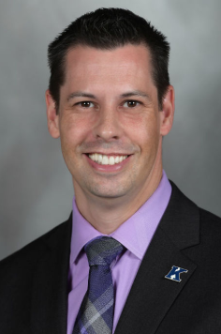
Tips for Applying for ACSM Fellowship: Fear of Applying
J. Derek Kingsley, PhD FACSM
Kent State University
Associate Professor, Exercise Science/Physiology jkingsle@kent.edu
(O) 330-672-0222

Slide 2
Conquering Fear
Understand the process.
Be prepared.
Take your time.
Be consistent.
Seek assistance.

Slide 3
Understand the Process
For more information watch the video by Dr. Dumke as he delves into what the Committee does!
  Applications are due in February and August.
  The Committee evaluates each application, we vote, and then we discuss.
  Letters go out in April and November.

Slide 4
Be Prepared
Do your homework and choose the appropriate pathway for you.
  Be sure to watch Drs. Smith and Blauwet for more information!!
Understand how the points work.
It takes time to develop a quality application for Fellowship.

Slide 5
Take Your Time
Lots of way to get involved and earn points. If in doubt watch Dr. Keith’s video as she illustrates the many ways to get involved!
  Regional Chapters
  National ACSM
  The Field (University, College/School, and the Community)

Slide 6
Take Your Time
When filling out the application there are a few areas where there is an open response.
  We sometimes find typos, information that is inconsistent, and/or poor answers.
    Be sure to be specific in your answers about why Fellowship is important to your goals, what committees you think are a good fit for you, etc.
  These things are immediate red flags.

Slide 7
Be Consistent
Everything is vetted by ACSM prior to getting to the Committee.
As a Committee we sometimes see items mentioned in one area of the application, and not in others like the CV.
Inconsistencies are immediate red flags.

Slide 8
Seek Assistance
The Committee closely evaluates the letters of recommendation from current Fellows so be sure they know you and your work.
  You can always seek assistance from them, or any other Fellow, on or off the Committee.
    If mentored by someone on the Committee, they will be unable to vote but can defend your application.
ACSM offers great programs.
  Mentoring Women to Fellowship (Chaired by Dr. Keith!!)
  https://www.multibriefs.com/briefs/acsm/active111417.htm

Slide 9
Conquering Fear
Plan ahead.
Find ways to get involved.
If you have questions, ask
  Me: J. Derek Kingsley, PhD FACSM, jkingsle@kent.edu
  ACSM: Heather Drake, hdrake@acsm.org

