Slide 1
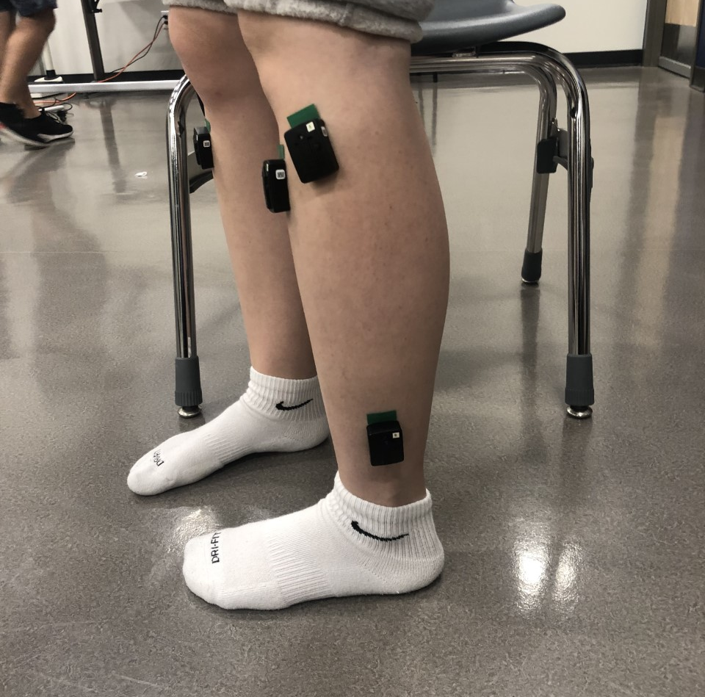
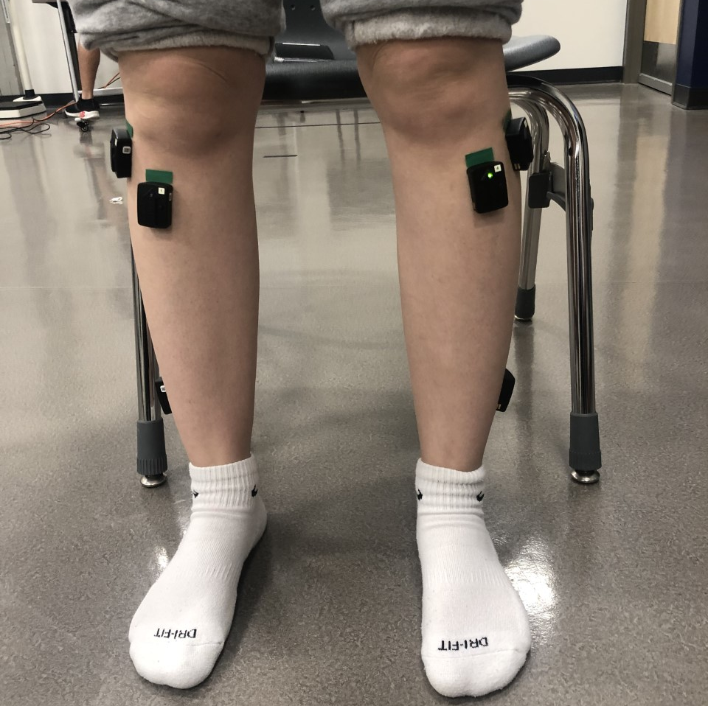
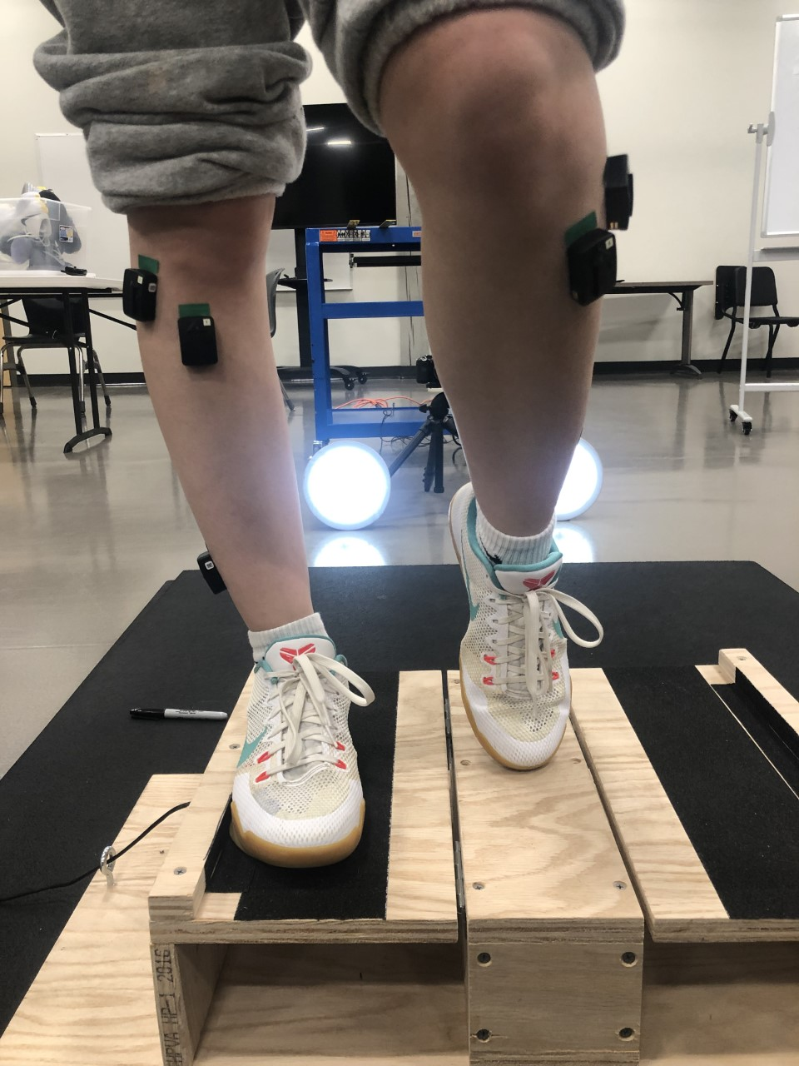
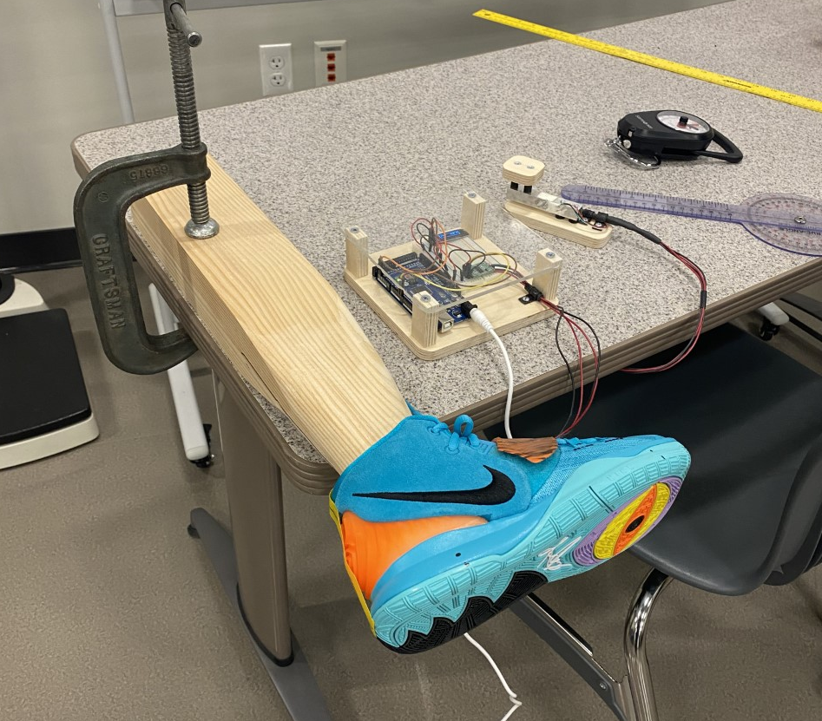
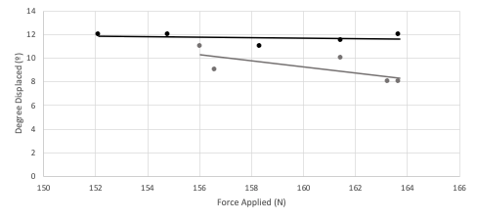
Comparison of Lateral Ankle Stability Between High and Low Collared Shoes: A Pilot Study
L. Hermann¹, Y. Ryan¹, A. Buchalski¹, G. Mateo¹, R. McCulloch¹
Department of Human Physiology, Gonzaga University, Spokane, WA
Abstract
Methods
Results
An ankle sprain is an injury to the ligaments of the ankle joint and one of the most common injuries for basketball players. Injuries to the lateral-ligament complex caused by ankle inversion are the most common sprains, often occurring with excessive foot inversion and plantar flexion when landing on an uneven surface. PURPOSE: This study examined differences in ankle support between high top and low top shoes, while analyzing the effects of ankle stabilizing muscle activity during landing. METHODS: This was a methodological pilot study consisting of two parts. An anatomical simulation test was performed to measure the force it takes to displace both high and low top shoes to a 30° inversion angle from two different locations on the lateral side of the shoe sole, incorporating a leg model and a force transducer. A drop box stability test was performed in both shoe types to measure muscle activity and inversion angle of the ankle during a simulated ankle sprain for both right and left feet. The drop box inverted to an angle of 30°. Surface electrodes were placed on the tibialis anterior, peroneus brevis and peroneus longus to measure muscle activation through electromyography (EMG) during the drop box trials and were normalized to maximum voluntary contractions. One foot was placed on the platform to be inverted, using the opposite foot strictly for balance on the stable platform of the box. Participants were informed they were to experience an unexpected sudden ankle rotation when the support block was pulled. Muscle activity and drop ankle angle, measured with motion capture, were collected during trials. RESULTS: Anatomical simulation trials showed significant strong relationships between force applied and degree of inversion. Drop Box Shoe stability trials were showed increased ankle inversion angle in a low collar vs. high collar. The drop box also showed increased mean muscle activity in the peroneus longus in the high collared shoes compared to low collared shoes, whereas the other two muscles had lower mean activity levels in high collared shoes. CONCLUSION: A greater lateral force will positively influence the angle of shoe inversion of the high and low collared styles. A drop box can be used to determine the effects of shoe design on ankle injuries by accurately simulating the landing experienced in basketball ankle injuries.
EMG: Surface electrodes were placed on the tibialis anterior, peroneus longus and peroneus longus to record muscle activity during simulated sudden ankle inversion (Figure 1). Participants performed maximum voluntary isometric contraction (MVIC) against applied resistance to normalize EMG data collection.
Drop Box Shoe Stability Test: A participant was asked to stand on top of an inversion simulation platform with a 30° pivoting foot base simulating ankle inversion. The participant placed one foot on the platform, while the other foot was used strictly for balance (Figure 3). Participants were informed they were to experience an unexpected sudden ankle rotation when the support block is pulled. A camera at a shutter speed of 1/500 of a second was used to record the drop in order to measure the angle of ankle inversion relative to the leg. Three reference points were drawn on the base of the shoe heel, peak of the shoe heel and three inches above the peak heel marker. EMG muscle activity was recorded during each trial performed.
Statistical Analysis: Data was analyzed using SPSS Statistics 25. For the mannequin leg shoe stability test, two t-tests were conducted for 10º displacement between high and low top shoes, one for force applied at 20% from the front of the shoe and one for force applied at 80% from the front of the shoe. For 20º displacement, regressions were run for force applied at 20% from the front of the shoe for high and low collared shoes. Drop tape angles were analyzed and measured using Kinovea ®. The drop box shoe stability test was analyzed using a one sample t-test to determine if there are any differences among the right and left shoe taping angles between the high top and low top shoes and 30°. Using the normalized EMG data we analyzed if any differences are present among the three measured muscles using an ANOVA: tibialis anterior, peroneus brevis and peroneus longus.
Anatomical Stimulation Test: There was a detectable difference between high (M=110.48, SD=18.87) and low (M=151.74, SD=17.40) collared shoes for 10º displacement from a force applied at 20% from the front of the shoe. Similarly, there was also difference able to be detected between high (M=24.26, SD=4.89) and low (M=31.89, SD=2.15) collared shoes for 10º displacement from a force applied at 80% from the front of the shoe. For these trials the displacement angle ranged from 8-12º. For the trials measuring the force to displace the shoe 20º there was a strong relationship able to be detected between force and displacement angle for both high and low collared shoes seen in Figure 4. Force was detected to be a predictor for displacement angle within high collar shoes, R²=0.979 (Figure 4). Force was also detected to be a predictor for displacement angle within low collar shoes, R²= 0.973 (Figure 4).
Drop Box Shoe Stability Test: There was no differences able to be detected for the tibialis anterior muscle activity between high and low collar shoe styles. Similarly, there is no significant difference detected for the peroneus longus or brevis muscle activity between high and low collar shoe styles. However, for the peroneus longus the mean activity was detected to be higher in the high collar (M=184.99, SD=111.44) than low collar shoe (M=161.72, SD=93.69).There was no detectable difference between the low collar shoes (M=29.083, SD= 2.518) and 30º (Table 2). There was a significant difference found between the high collar shoes (M=28.167, SD= 3.535) and 30º, t(23)=2.541, p=0.018 (Table 2). All means and standard deviations can be seen in Table 2.
Table 1. EMG percent activity and drop tape angles for high and low top styled shoes.
Shoe Collar Height | Drop Tape Angles (°) (Mean 土 Standard Deviation) | Tibialis Anterior activity level (%) (Mean 土 Standard Deviation) | Peroneus Longus activity level (%) (Mean 土 Standard Deviation) | Peroneus Brevis activity level (%)) (Mean 土 Standard Deviation)
Low | 28.16 土 3.53* | 96.04 土 100.76 | 161.72 土 93.69 | 145.94 土 115.39
High | 29.08 土 2.51 | 67.10 土 16.72 | 184.99 土 111.44 | 122.60 土 34.22
*indicates where detectable difference was found
Figure 1 A: Surface electrode placement on left leg B: Surface electrode placement on both legs
Introduction
Injuries to the lateral-ligament complex caused by ankle inversion are the most common ankle sprains, often occurring during touchdown with excessive inversion and plantar flexion of the foot when landing on an uneven surface (4,3)
The function of a high-shoe collar, synonymously termed as high-top shoe, is to reduce excessive ankle supination and improve ankle stability during cutting and landing movements (2). This is accomplished by reducing the range of motion in eversion and plantar flexion (1)
Prelanding muscle activity of the peroneus longus, peroneus brevis, and tibialis anterior have been termed “pre-activation or preparatory muscle activity” and have been found to contribute to restricting movements causing potential ankle sprains, such as plantar flexion and inversion of the ankle (3).
Shoes have been found to partially influence the timing and amplitude of evertor muscle activity before touchdown landing movements (3). Theoretically, earlier onsets and larger amplitudes of pre-landing EMG activity are considered crucial to prepare the foot positioning at touch-down (3).
While high top shoes have been found to reduce ankle range of motion, and consequently, improve ankle stability, they have also resulted in significantly later onset times of the tibialis anterior and peroneus brevis muscle activity, and decreased prelanding EMG activation of the ankle evertor muscle on an inverted surface (2,3).
Purpose: Prove methodology to determine the differences in ankle support between high top and low top shoes, while analyzing the effects of ankle stabilizing muscle activity during landing. More specifically, while analyzing the reason there is more, less, or no difference in muscular activity between high and low top shoes.
We hypothesized that methodology supports idea that 1) low top shoes will provide the same amount of stability to the ankle as the high-top shoe, and 2) There will be more muscle activity of the tibialis anterior, peroneus brevis, and peroneus longus in a low top shoe than compared to the high-top shoe.
Discussion and Conclusion
There was a strong relationship detected between force applied and displacement (Figure 4), therefore it supports past evidence that increased force will result in an increased inversion angle during an ankle sprain.
More displacement occurs when force is applied to the back of the shoes, rather than the front.
This would make sense that more displacement occurs at the back of the shoe, rather than the front, in terms of ankle sprains.
However, it seems that investigators found no significant correlation between this part of the foot and lateral ankle sprains (5).
Our results showed preliminary evidence that shoe collar height could influence percent EMG activation of evertor muscle activity. Specifically, the tibialis anterior and peroneus brevis showed less activation in high top shoes than low top shoes.
These findings provide evidence suggesting that high top shoes result in a smaller muscular effort and changed proprioceptive feedback.
Our results also showed that the high-top shoes induced higher muscle activity of the peroneus longus than low-top shoes.
As the tibialis anterior and the peroneus brevis muscles had a lower muscular effort, potentially due to the rigidity of the shoe, it is possible that, due to a later onset time, the peroneus longus carried a greater burden to protect the joint and stimulated a greater EMG amplitude
Due to COVID-19, our sample size was limited to only four participants, thus reducing the power of our study and increasing the margin of error, as well as higher variability. This study was used to prove methodology.
Shoe design is also a limitation for our study. All of the high top shoes were not considered to be true high tops. However, there was a noticeable difference in shoe collar height between the low top and “high” top shoes.
Conclusion: Shoe collar height did significantly influence shoe displacement; therefore, our first hypothesis is accepted. However, shoe collar height did not significantly influence evertor muscle activation, therefore our second hypothesis is rejected. Additionally, it was found that a greater force impact will positively influence the angle of inversion upon landing. Therefore, methodology showed to be effective for use in future related studies.
Figure 2: Set up of Anatomical Stimulation Test
Figure 3: Example of foot placement during Drop Box Shoe Stability Test
Methods
References
Participants Selection: 30 male and female participants were proposed for this study. Participants were to be selected from Gonzaga University under the criteria that participants consistently play basketball at least one time per week or have participated in a previous regularly organized basketball experience. For this pilot study and methodological analysis, participants consisted of two male and two female researchers from Gonzaga University. Participant exposure to basketball ranged from frequent to no exposure.
Anthropometrics: Height (m) and weight (kg) was collected using a scale with a stadiometer. BMI was then calculated using the following formula: BMI = weight (kg) / height (m). Body fat percent was collected using a bioelectrical impedance analyzer.
Shoes: The four participants each attained one low collar and one high collar shoe. Female shoe sizes ranged from 6 to 8.5. Male shoe sizes ranged from 10.5-12.
Anatomical Stimulation Test: A shoe tied on a mannequin leg was suspended to a table with a force transducer resting next to the leg on the table (Figure 2). Force was applied to two locations on the lateral side of the shoe sole, at the heel (80% from the front of the shoe) and at the forefoot (20% from the front of the shoe). The force it takes to displace a high top and low top shoe to a 30° inversion angle was recorded. Two forces were initially recorded; the first 10° of displacement, the final 20° of displacement. Those two forces were summed together to determine the whole 30° of displacement.
1. Brizuela, G., Llana, S., Ferrandis, R., & Garcia-Belenguer, A. C. (1997). The influence of basketball shoes with increased ankle support on shock attenuation and performance in running and jumping. Journal of Sports Sciences, 15(5), 505–515.
2. Frederick, E. C. (1995, June). Biomechanical requirements of basketball shoes. In Proceedings of the second symposium of the ISB working group on functional footwear (pp. 18-19). Cologne: International Society of Biomechanics.
3. Fu, W., Fang, Y., Liu, Y., & Hou, J. (2014). The effect of high-top and low-top shoes on ankle inversion kinematics and muscle activation in landing on a tilted surface. Journal of Foot and Ankle Research, 7(1), 14.
4. Lynch, S. A. (2002). Assessment of the injured ankle in the athlete. Journal of Athletic Training, 37(4), 406-412. Retrieved from PubMed database. Retrieved from https://www.ncbi.nlm.nih.
Results
Figure 4. The degree displacement for an applied force on high and low collared shoes during anatomical stimulation test. Light grey depicts low collared regression and black depicts high collared regression.
Acknowledgements
Our group would like to thank Ryan McCulloch for building the drop-box platform used for the drop box stability testing, as well as the making the force transducer used for measuring force applied to the shoes on the mannequin leg.
Notes:
Hello, my name is laurel Hermann, and my research partners and I did a pilot study to evaluate the methodology in comparing lateral angle stability between high and low collared basketball shoes.

